Slide 1

Car Price Predictions
Ismail AlKamal
Nov 15, 2021

Slide 2

Business Problem
A new car manufacturer plans to enter the US market and wants to:
- Understand how car prices vary with different variables.
- Design cars and implement strategies to meet certain price levels.

Slide 3
Dataset
Source:
https://www.kaggle.com/hellbuoy/car-price-prediction
Features: 26
Entries: 205
Description:
A large data set of different types of cars across the US

Slide 4
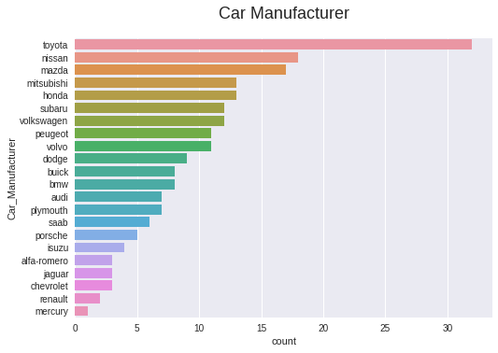
Data Sample Representation
Japanese Car Manufacturers account for 50% of the dataset

Slide 5
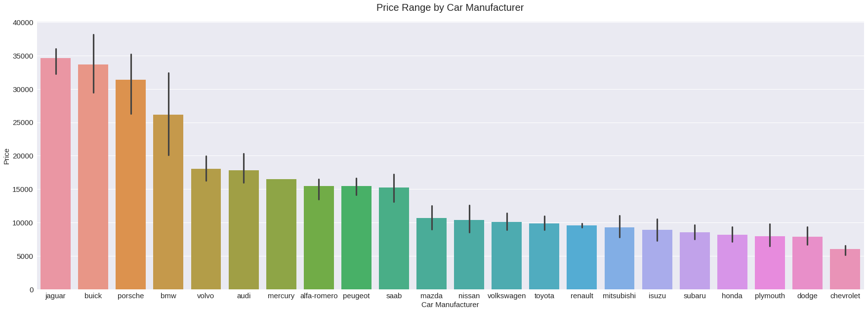
Car Prices vs Manufacturers
Jaguars, Buicks, Porsches, BMWs and Volvos are the most expensive.
Subarus, Hondas, Plymouths, Dodges and Chevrolets are the least expensive.

Slide 6
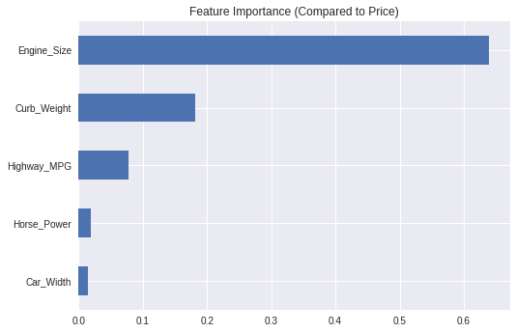
Most Important Features in Determining Price
The most important 5 features in determining car price are:
Engine Size
Curb Weight
Highway MPG ( - )
Horse Power
Car Width

Slide 7
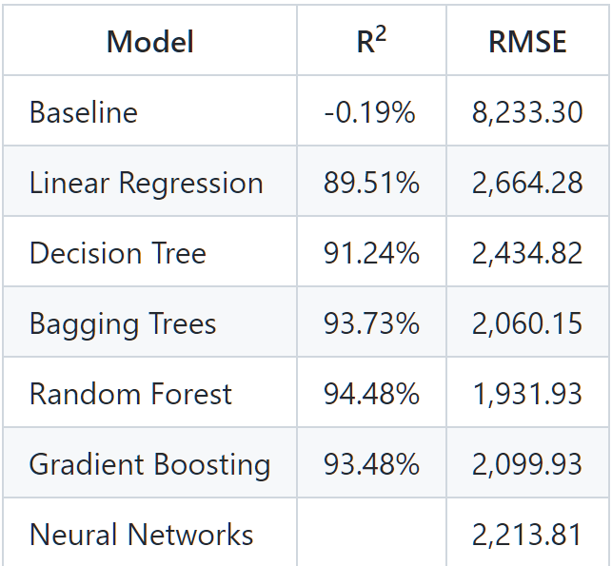
Prediction Models
Six prediction models were used including linear regression, decision trees, bagging trees, random forest, gradient boosting and neural networks.
The best model was Random Forest and with Hypertuning, we were able to reduce the prediction error to less than $2,000.

Slide 8
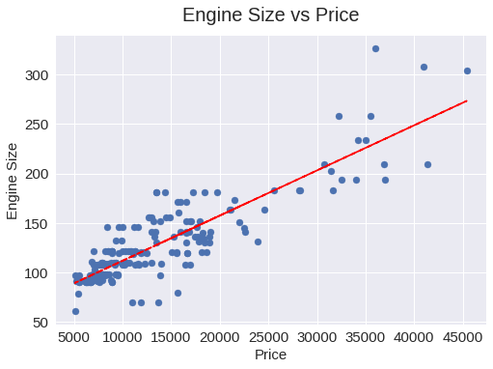
Recommendation
My recommendation is to focus on:
Engine size
Curb Weight
Highway MPG
as the main factors in determining car price.

Slide 9
Thank you

